Slide 1
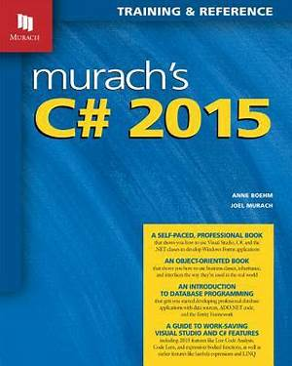
Programming
Lecture 13
Windows Form Part 4

Slide 2
Agenda
ListView
DataGridView
Data Binding

Slide 3
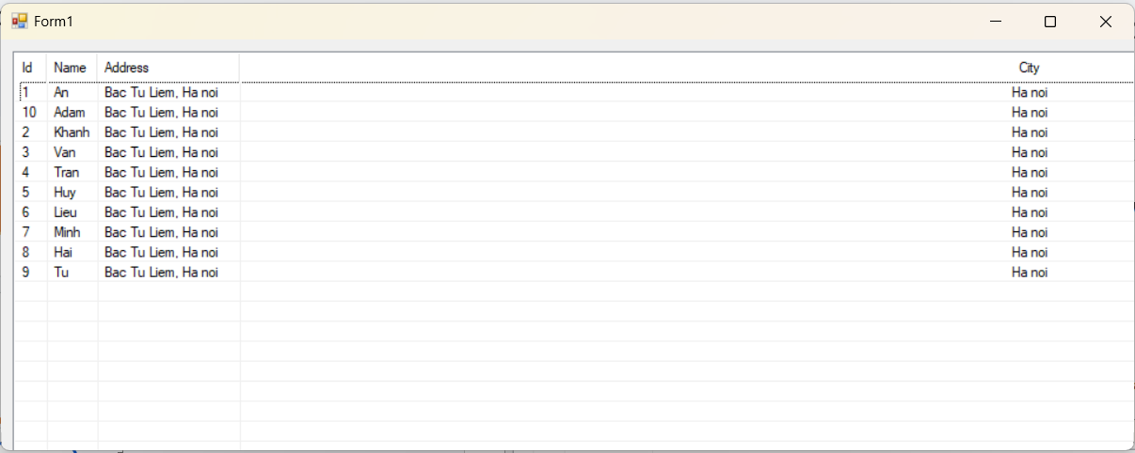
ListView
Definition
Represents a Windows listview control, which displays a collection of items that can be displayed using one of four different views.

Slide 4
ListView
Have 2 options to create ListView
ListView in Design
ListView in Run-time

Slide 5
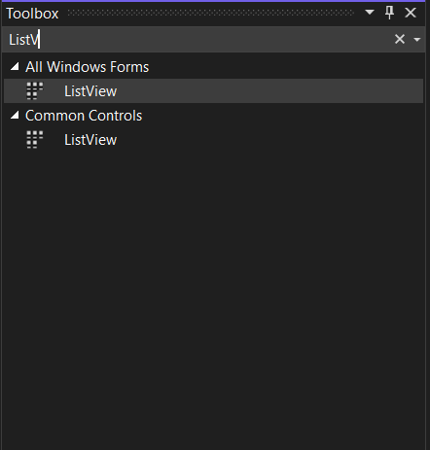
ListView
ListView in Design
Toolbox -> search ListView and drag ListView to Form Design

Slide 6
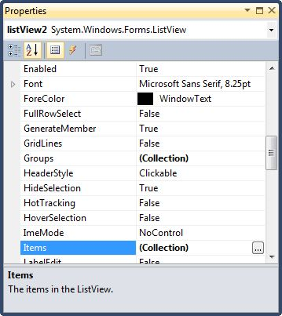
ListView
ListView in Design
Properties -> Items -> Click on the Items Collection

Slide 7
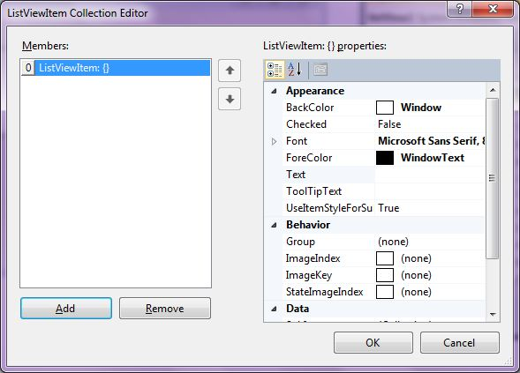
ListView
ListView in Design
Change Text value -> Add to add item to ListView

Slide 8
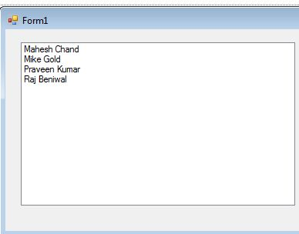
ListView
ListView in Design
Result

Slide 9
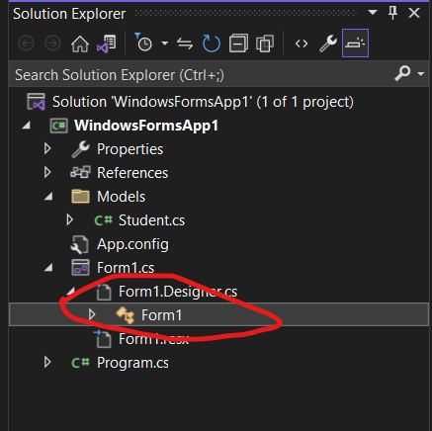
ListView
ListView in Run-time
Open Form1.cs to setup ListView
Go to Form1.Designer.cs -> Form1

Slide 10
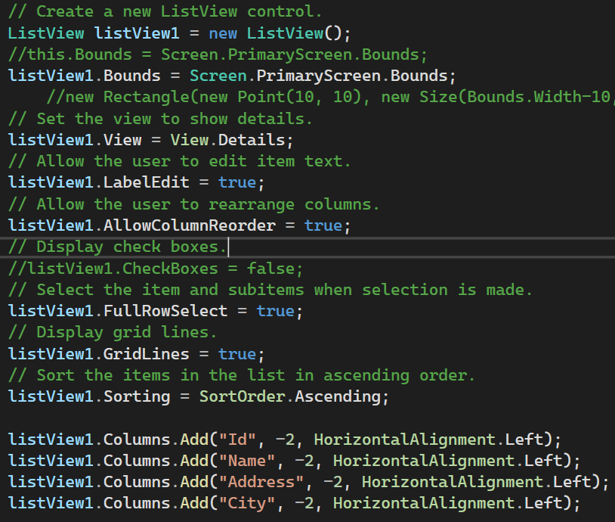
ListView
Custom ListView
Set Bound
Set GridLines
Set Columns
Allow Column Reorder

Slide 11
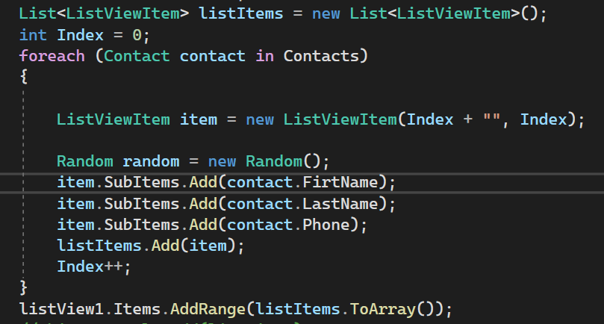
ListView
SetData ListView
ListView setData: using ListView.Items.AddRange(Array Object)

Slide 12
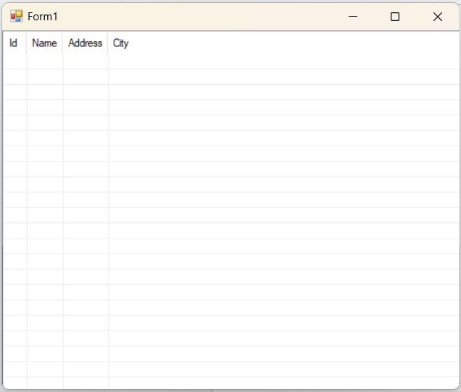
ListView
Result

Slide 13
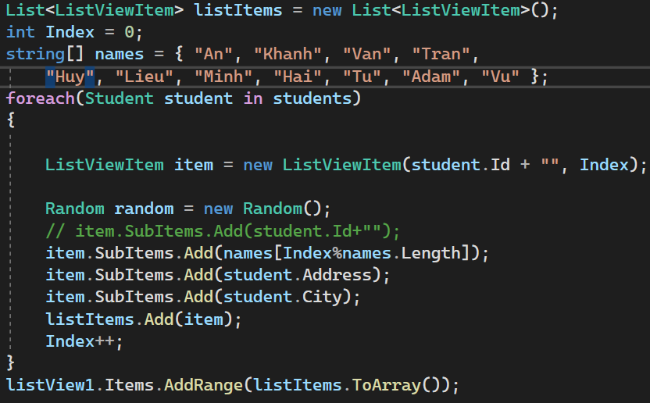
ListView
ListView in Run-time
Set Data to ListView

Slide 14
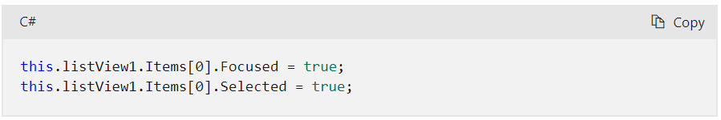
ListView
ListView focused item
If want to set the item as focused when selecting an item in ListView

Slide 15
ListView
ListView selected index
// Uses the SelectedItems property to retrieve and tally the price
// of the selected menu items.
private void ListView1_SelectedIndexChanged_UsingItems(
object sender, System.EventArgs e)
{
int index =
this.ListView1.SelectedItems;
}

Slide 16
Question 1
How to: Add and Remove Items with the Windows Forms ListView Control
Describes how to add or remove items from a list view.
How to: Add Columns to the Windows Forms ListView Control
Describes how to create columns in order to display information about each list item.
How to: Display Icons for the Windows Forms ListView Control
Describes how to associate a list view with an appropriate image list for displaying large or small icons.
How to: Display Subitems in Columns with the Windows Forms ListView Control
Describes how to display information about each list item in columns.

Slide 17
Question 2
How to: Select an Item in the Windows Forms ListView Control
Describes how to programmatically select an item.
How to: Group Items in a Windows Forms ListView Control
Describes how to create groups for categorized display and how to assign items to each group.
How to: Enable Tile View in a Windows Forms ListView Control
Describes how to display items as tiles, each of which is comprised of a large icon and multiple lines of text.

Slide 18
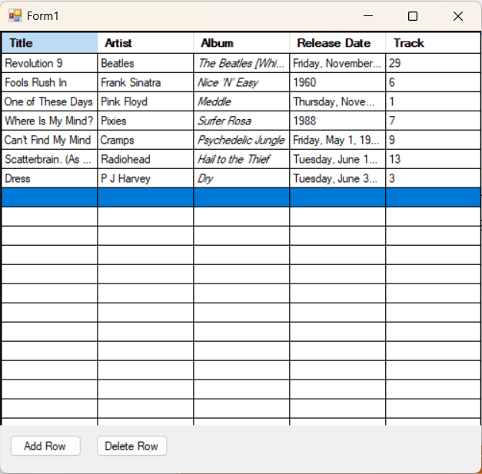
DataGridView
Example

Slide 19
DataGridView
DataGridView Definition
The DataGridView control provides a customizable table for displaying data.
The DataGridView class allows customization of cells, rows, columns, and borders through the use of properties such as DefaultCellStyle, ColumnHeadersDefaultCellStyle, CellBorderStyle, and GridColor.
Use a DataGridView control to display data with or without an underlying data source.

Slide 20
DataGridView
DataGridView Definition
Without specifying a data source, you can create columns and rows that contain data and add them directly to the DataGridView using the Rows and Columns properties.
Use the Rows collection to access DataGridViewRow objects and the DataGridViewRow.Cells property to read or write cell values directly.
The Item[] indexer also provides direct access to cells.

Slide 21
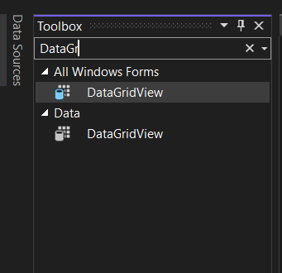
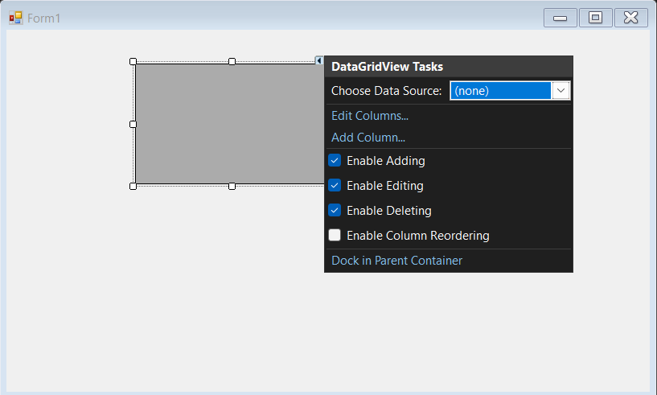
DataGridView
DataGridView in UI
Toolbox -> DataGridView

Slide 22
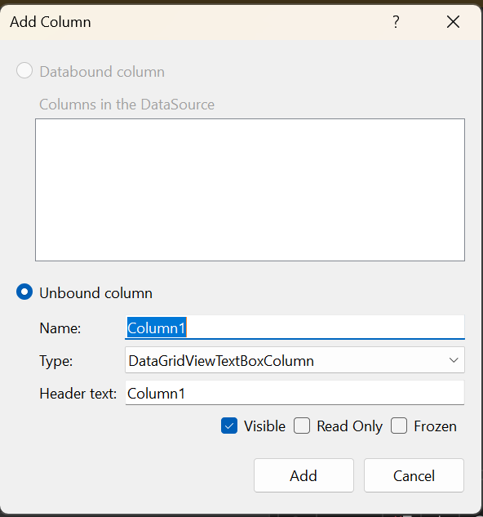
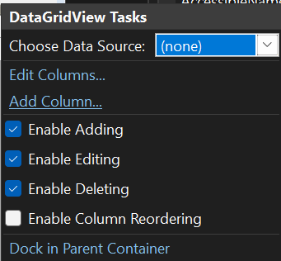
DataGridView
Add Columns
Choice Add Column -> Add
1
2

Slide 23
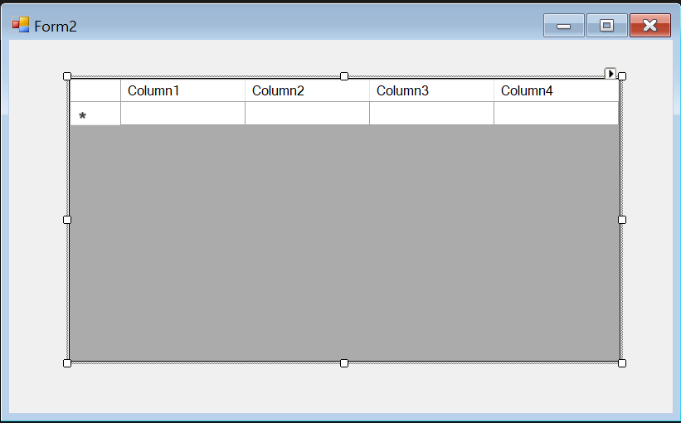
DataGridView
Result

Slide 24
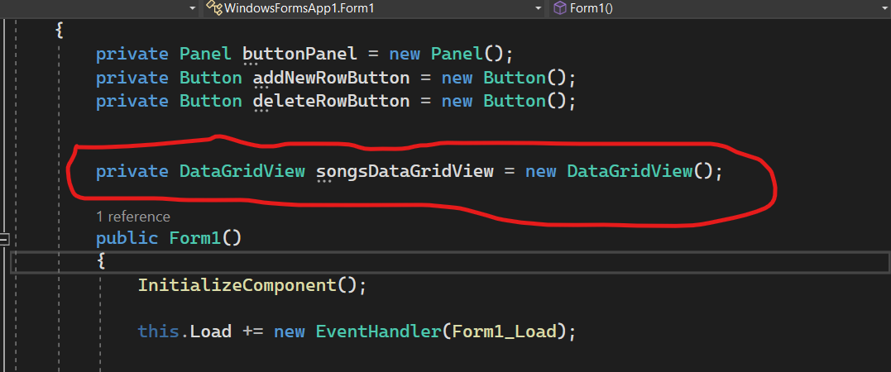
DataGridView
DataGridView in Source Code
In Form1.cs declare DataGridView

Slide 25
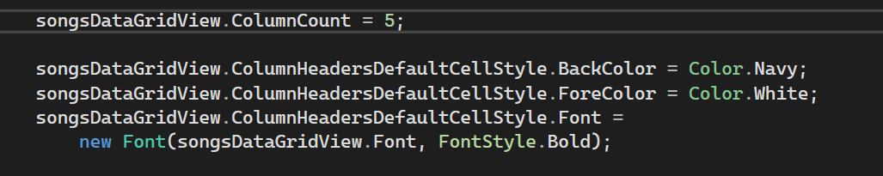
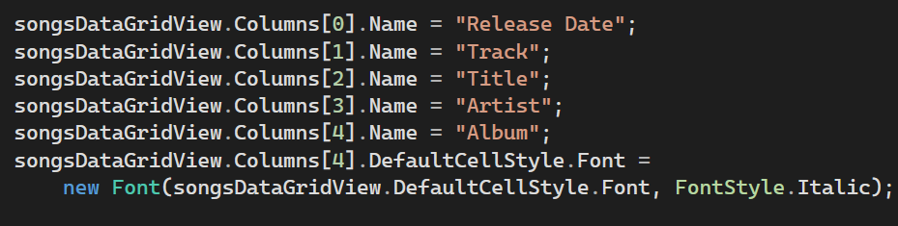
DataGridView
Set ColumnCount
Set Column Name

Slide 26
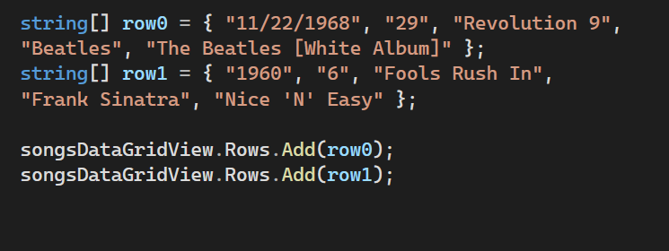
DataGridView
Set Data to DataGridView

Slide 27
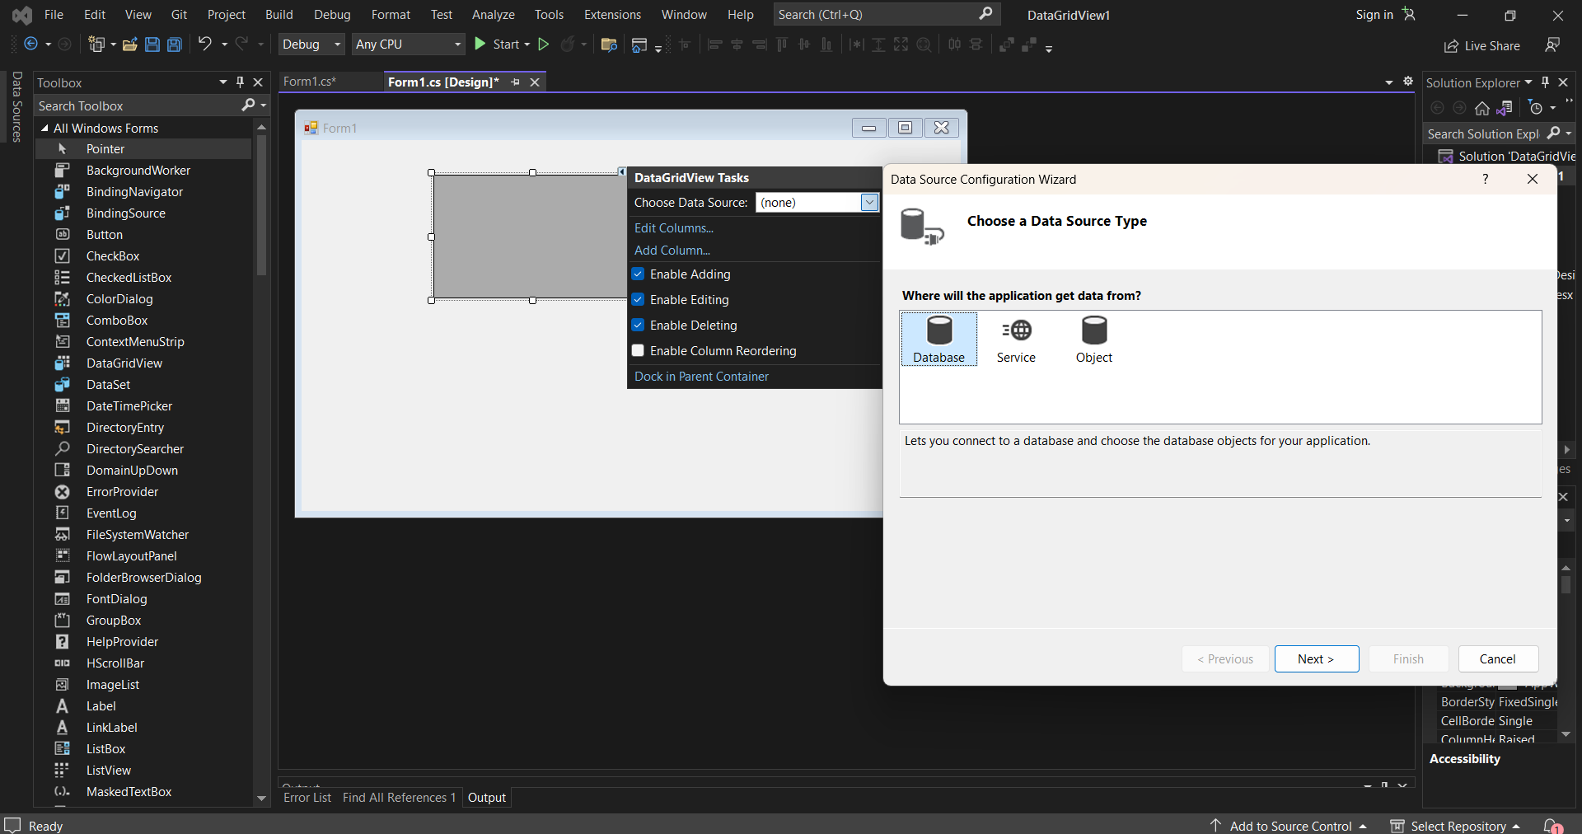
DataBinding
Connect Database to display data on DataGridView

Slide 28
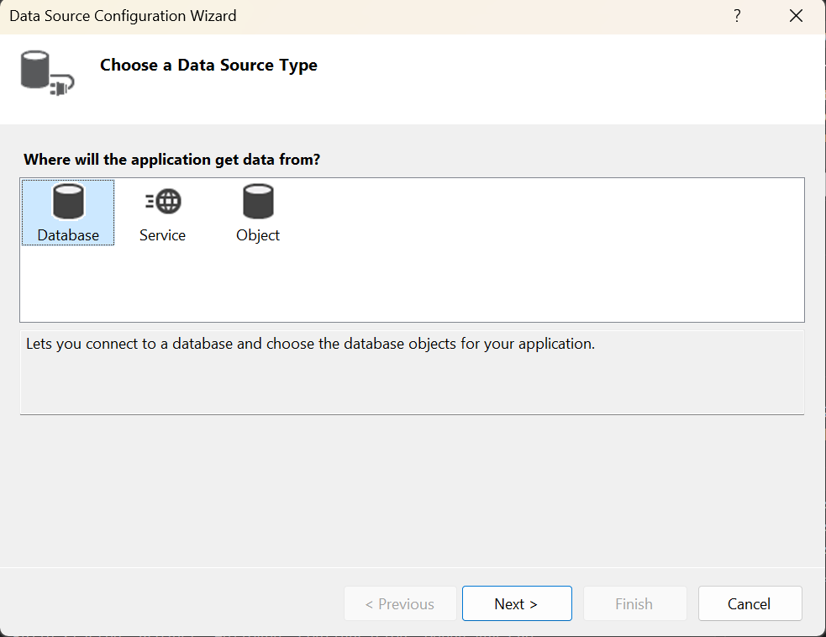
DataSource
Connect Database to display data on DataGridView
Can set the DataSource and DataMember properties to bind the DataGridView to a data source and automatically populate it with data (Database, Service, Object)

Slide 29
DataSource
Connect Database to display data on DataGridView

Slide 30
Question 3
How to: Bind Data to the Windows Forms DataGridView Control
How to: Add ToolTips to Individual Cells in a Windows Forms DataGridView Control
How to: Set Font and Color Styles in the Windows Forms DataGridView Control
How to: Change the Type of a Windows Forms DataGridView Column Using the Designer
How to: Bind Data to the Windows Forms DataGridView Control Using the Designer

Slide 31
Question 4
How to: Set Default Cell Styles and Data Formats for the Windows Forms DataGridView Control Using the Designer
How to: Format Data in the Windows Forms DataGridView Control
Walkthrough: Validating Data in the Windows Forms DataGridView Control
How to: Customize Data Formatting in the Windows Forms DataGridView Control
Walkthrough: Creating a Master/Detail Form Using Two Windows Forms DataGridView Controls

Slide 32
Thank you!
Notes:
32

